Slide 1
Firewall Networks (FireNet)
www.aviatrix.com
Solutions Engineering

Slide 2


Security Solution Approach in the Cloud
Layered Security Model - Defense in depth
  Intra-Spoke Traffic – L4 Inspection
  Best handled by L4 SG/NSGs
  Lifecycle tied with compute instances (CI/CD)
  Provisioned/de-provisioned by automation
Centralized L4 FW at Transit
Centralized NGFW at Transit
Distributed L4 at SG/NSG for Intra-VPC/VNet
  Ingress/Egress from Spoke – L4 Inspection
  Handle via a centralized L4 FW
  Relieves NGFW from basic L4 work
  However, for scale and centralized policy via same NGFW, centralized L4 should be done by NGFW
Centralized
NetSec
  Ingress/Egress from Spoke – L7 Inspection
  Best handled via a specialized NGFW
  Transparent Service Insertion
  Centralized security policy from NGFW platform
1
Notes:
Not one-size-fits all
Distributed L4: Security at an instance level. AWS SG only does allow; Azure NSG is optional but does allow and deny. Handled by Developers.
Centralized L4 is not ideal if you have a PAN to do Centralized Policy Mgmt
Centralized L7 is when you do want NGFW PAN for Centralized Policy/Mgmt. Service insertion should be Transparent (i.e. never require SNAT because Spoke GW (where workloads are) will never see the original source; instead, they will see the FW as the source IP. The only exception for this SNAT requirement is if the traffic needs to go out on the Internet.

Slide 3
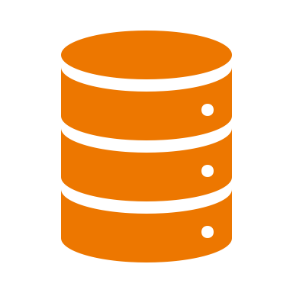



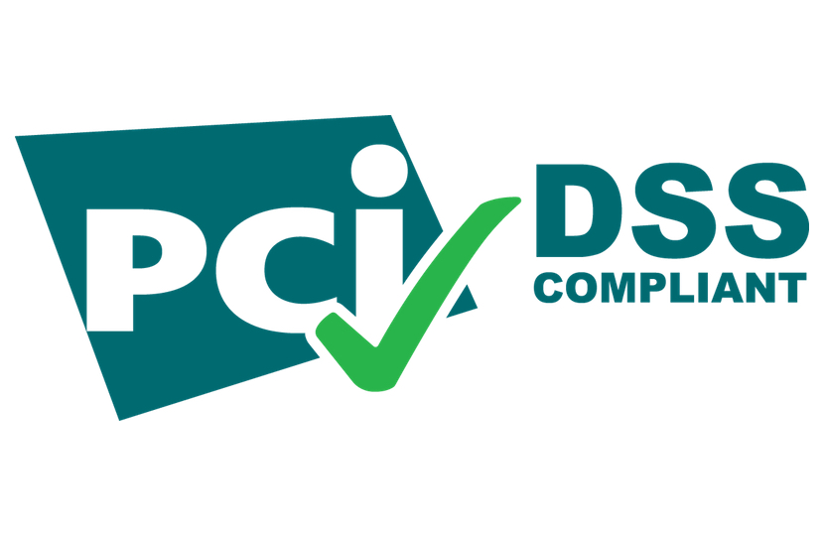

Ingress/Egress From Spoke – L7 Inspection
Business and Technical Requirements
Consumer/PII Data
InfoSec. mandates that certain or all traffic must
go through the NGFW for L7 Inspection
  Business Drivers: Security, Compliance, Audit, etc.
  Technical Need: NGFW, DPI, IDS/IPS, etc.
Existing processes and skillset on specific vendors
  Compliance achieved using a certain design and feature set
  Desire to maintain compliance with limited impact

Slide 4
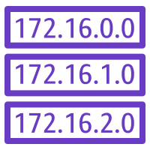



Traffic Patterns Requiring NGFW
AWS
INTERNET
GCP
AWS
VPC
VPC
VPC
VPC
Azure
VPC
Firewall Network
VNET
Inter-VPC/VNet
Ingress-Egress to/from Internet
Data Center
Partners / Sites / Branches
Inter-Region / Inter-Cloud
Partner Site
Branch
Data Center
Notes:
Need traffic inspection for different BUs across VPCs
E.g. Web apps that need access to Internet or Services. Remember that Internet Egress varies across CSPs (e.g. AWS has Public Subnet concept, others don’t)
E.g. DC with on-prem FW that is costing a lot because of Power, real-estate, CapEx. DC consolidation → Cloud gives consumption model
Trust level is less with Partners/Branches
Inter-region.
Now we need to figure out how to Service-Chain the FWs, how do we scale it out, how do we manage HA, how do we ensure symmetric flows

Slide 5
Challenges of Service Insertion in the Cloud
Firewall Vendors
Cloud Provider
Customer
Firewall vendors have repackaged on-prem solutions to cloud
Not focused to solve cloud networking and challenges
Expect customer to own routing traffic to and from FWs
Solution which might lack enterprise features you need
Expect customer to figure out routing traffic to and from FWs
Manually figure out routing and troubleshooting
Many components involved that require individual config/ops (LB, NAT GWs,
routes, etc.)
Lack of visibility and troubleshooting tools
Lack of visibility and troubleshooting tools reduces efficiency and increases risk
Notes:
Firewall Vendors: Forklifted solutions. Getting the packet to me is not my problem
Cloud Provider: Traditionally L4 solutions, but with minimal route orchestration and zero visibility. We give you the pieces. You stitch them together.
Azure Premium FW and AWS Network FW are MVP products.

Slide 6
Complexity of Deploying PAN Firewalls in the Cloud
Specific to VM-Series, lots of documentation available
  Choose a cloud
  Read Reference Architecture
  Choose a Deployment Model
  Read Deployment Guide for chosen Deployment Model
  Deploy VM-Series successfully (hopefully)
  Rinse and Repeat …
https://www.paloaltonetworks.com/resources/reference-architectures
5
Notes:
Visiting this hyperlink will take you to landing pages for each CSP…

Slide 7
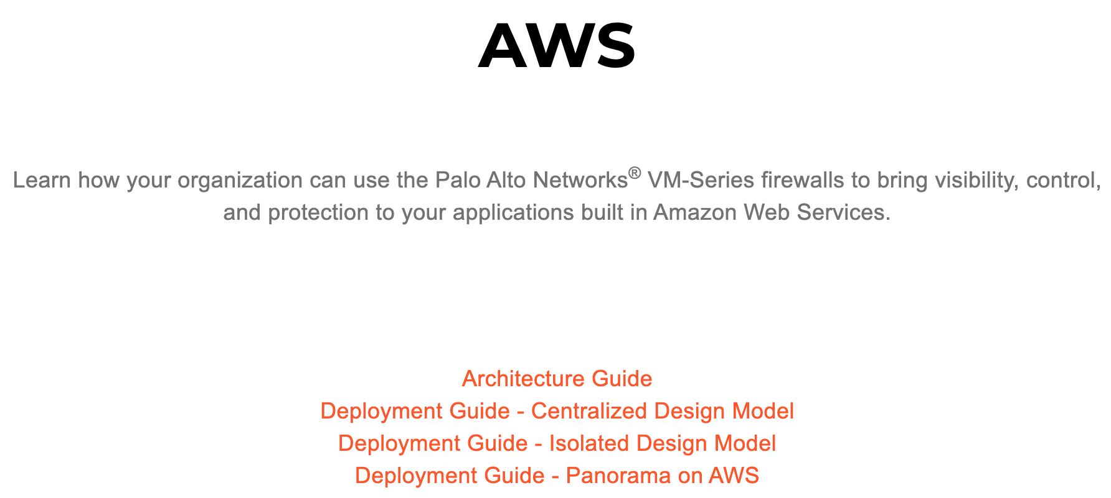
Long Reads in One Cloud…
84 page PDF!
126 page PDF!
94 page PDF!
38 page PDF!
Notes:
From PAN website

Slide 8
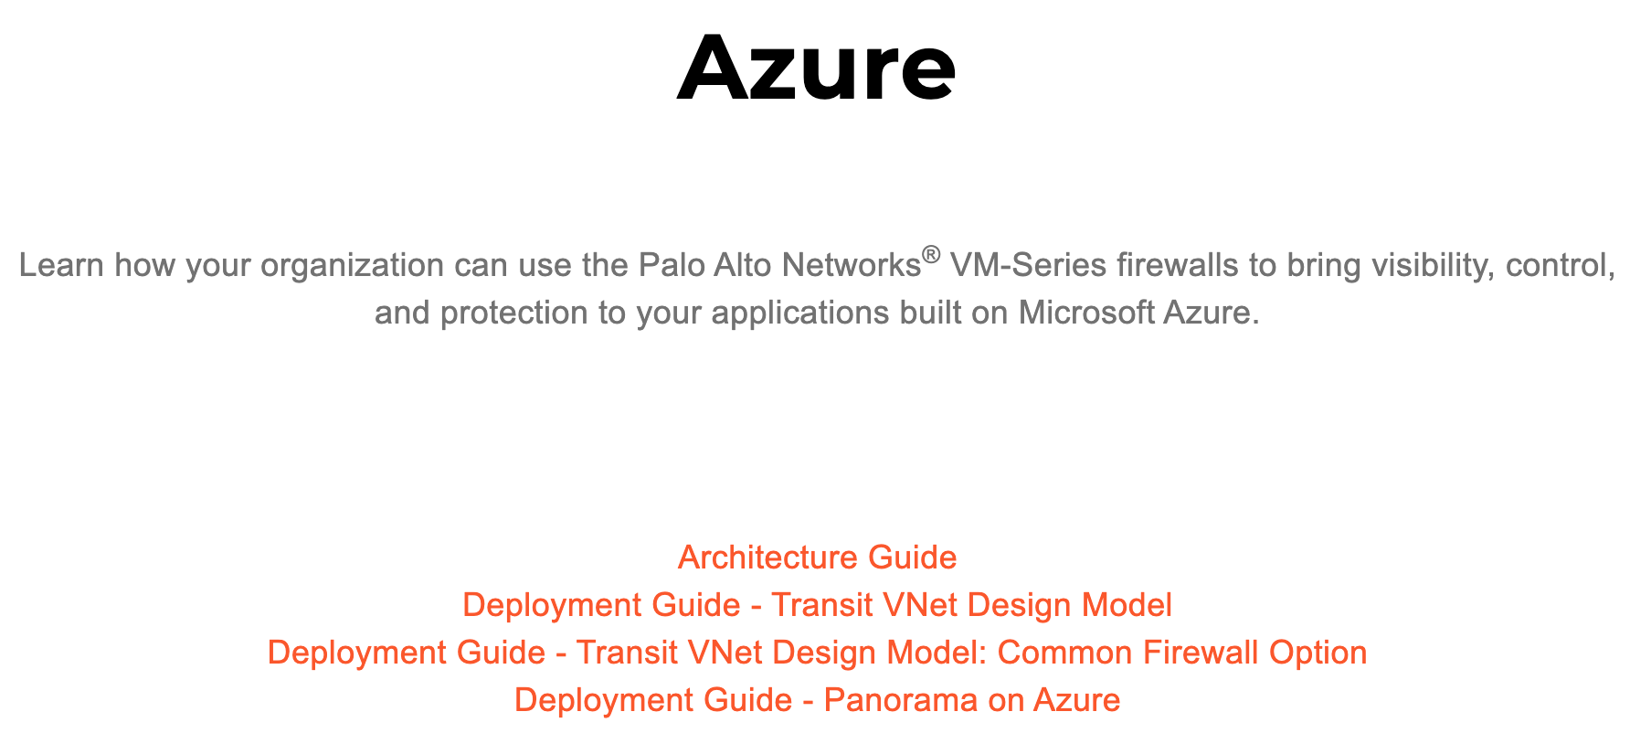
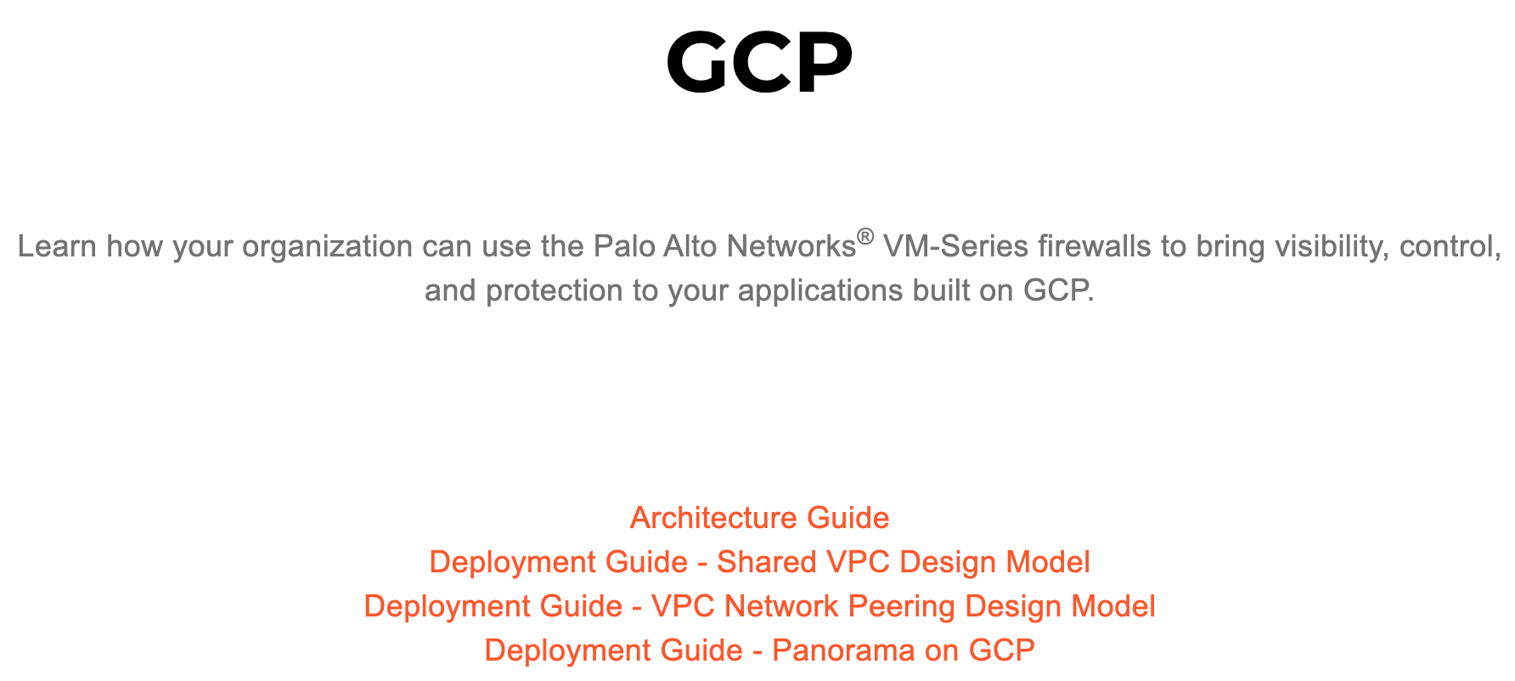
Long Reads in Other Clouds…
~500 pages of reading!
400+ pages of reading!
Notes:
CSPs are evolving and introducing new features/capabilities, security insertion design today may not apply in the future if using native constructs. E.g. AWS GWLB introduction turned things on its end. Does customer want to rearchitect?

Slide 9
Firewall Architecture Options in Public Cloud
  Aviatrix Solution – FWs integrated at Transit (L4/L7)
    Transit integrates L4 FW (centralize)
    Better performance and control for NetSec
    L4 and NGFW functions service chained to specialized 3rd party appliances
    Repeatable across regions and clouds
  3rd party NGFW (L4+L7)
    Mature security solutions and established skillset
    Inserting in traffic path is manual and error prone
    NGFW based transit lacks common control plane
    Route management / traffic steering is customer responsibility
Feature Maturity
  Instance level FWs - SG/NSG (L4 FWs)
    Sprawl of SGs/NSGs
    Governance, audit, and support challenges
    Helps in compliance but not sufficient on its own
  CSP provided L7
    Lacks deep security intelligence and maturity
    Lacks tooling for visibility and troubleshooting
    Inserting in traffic path is manual and error prone
Ease of Use
8
8
Notes:
Instance level FWs: With thousands of SGs, their governance becomes very difficult. Basic L4
CSP-provided L7 (AWS Network FW and Azure Premium FW) are very MVP.
FW vendors have mature feature set but lack orchestration
Avx gateways can be L4 FWs, but you a more common use case is service chaining with NGFWs (L7) along with the route orchestration, HA, and visibility

Slide 10
Aviatrix Transit FireNet

Slide 11






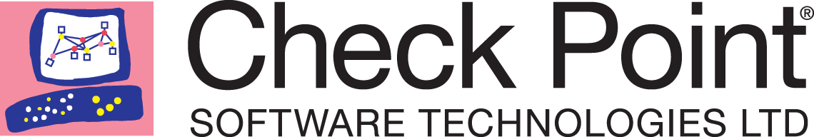
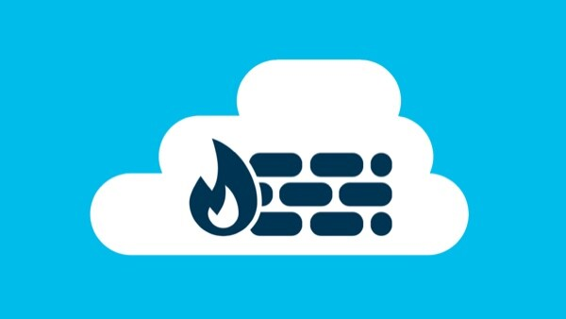

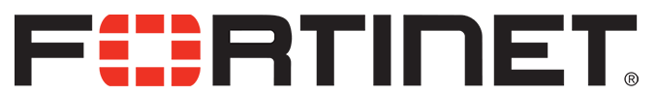
Aviatrix Encrypted Transit Firewall Network
Scale out, multi-AZ FW deployments
VPC/VNET
VPC/VNET
VPC/VNET
VPC/VNET
Automated route management. Segmentation and Connection Policies
Aviatrix ActiveMesh
Deep visibility and operational capabilities
Transit
Repeatable architecture, across regions and clouds
IPsec
VPN
Direct Connect/
Express Route
Bring Your Own Appliance
Notes:
Scale-out Full performance
Active/active
No BGP nor IPsec
Full visibility: no SNAT, GWs do flow-aware load-balancing
Also F5 SSL offloading
BYOA. Either Deploy FW via Step 7a or Consume via Step 7b by specifying the VPC/VNet and mapping LAN/WAN interfaces
If an AWS Transit Gateway connects to a firewall by using its built in VPN function, it must run IPSec and BGP. If you run more than one firewall instances by using ECMP, each firewall instance must configure SNAT function to ensure that both source and destination initiated traffic lands on the same firewall instance. Furthermore, since native deployment requires an IPSec VPN which limits its performance to 1Gbps, in this scenario a single firewall instance can only perform at 500Mbps since the VPN function is traversed twice.

Slide 12
Aviatrix Encrypted Transit Firewall Network
Aviatrix Controller deploys the Firewalls (UI, TF support)
Aviatrix Controller configures the interfaces and routing entries at the Firewalls
No SNAT, IPsec, BGP, or any other elements are required to insert the FWs into the traffic path
Aviatrix Controller ensures all the Spokes and other connected networks which are marked for inspection have their traffic inspected by the FW
Aviatrix Controller monitors the health of the FW instances and ensures the traffic is only forwarded to “up” Firewalls
Aviatrix GWs or a native cloud LB incorporated into the overall design ensure that the traffic is correctly load balanced to all available FWs, while maintaining the session stickiness
VPC/VNET
VPC/VNET
VPC/VNET
VPC/VNET
Aviatrix ActiveMesh
Transit
IPsec
VPN
Direct Connect/
Express Route
Notes:
Controller will also create subnets and routes on CSP
Key point: Controller has visibility into everything.
Load Balancers: You don’t need to know about the abstractions, but its good to know

Slide 13

Aviatrix Transit FireNet Performance
Spoke VPC/VNet
Aviatrix ActiveMesh
Transit VPC/VNet
AZ A
x 10 Firewalls
Spoke VPC/VNet
AZ B
x 10 Firewalls
Spoke VPC/VNet
80Gbps
~75Gbps on AWS
~75Gbps
Active/Active Firewalls
FireNet Policy to choose workload VPCs for inspection
Works across the board – no guesswork required
Notes:
Spoke -> Transit -> Spoke with no FW integration can reach 80Gbps.
With VM-Series, 70Gbps.
When you create Transit VPC/VNet, just check a box saying this is Transit FireNet-capable.
With a pair of c5n.18xlarge Aviatrix Transit Gateways: 70Gbps throughput with iperf3 benchmark.
If a single c5n.18xlarge Aviatrix Transit Gateway is deployed, the throughput is about 40Gbps. This is because Aviatrix Encrypted Transit solution runs with ActiveMesh where both Transit Gateways do the packet forwarding.
In Azure, with HPE, ~35Gbps FireNet throughput can be achieved

Slide 14
Aviatrix Transit FireNet Load Balancing and Failover
The Aviatrix Controller monitors the health of the Firewalls
Controller periodically checks Firewall
instance health
Session stickiness is maintained
  Existing sessions on working firewalls
  are not disturbed
  AKA resilient hashing
VPC/VNET
VPC/VNET
VPC/VNET
Transit
Notes:
Firewall health tracked on the LAN interface of the FW
(Polling time is 10 seconds)
Aviatrix FireNet Gateway failure detection time is 7-10 seconds with fast timers

Slide 15
Aviatrix Transit FireNet Failover
Spoke VPC
Aviatrix ActiveMesh
Transit VPC
AZ A
x 10 Firewalls
Spoke VPC
AZ B
x 10 Firewalls
Spoke VPC
Notes:
Firewalls failure:
AVX controller monitors Firewalls health via APIs
AVX controller updates route tables of the AVX transit GWs, to stop sending traffic to a Firewall which went down

Slide 16
Aviatrix Transit FireNet Failover
Spoke VPC
Aviatrix ActiveMesh
Transit VPC
AZ A
x 10 Firewalls
Spoke VPC
AZ B
x 10 Firewalls
Spoke VPC
Notes:
All Firewalls failure under a Transit GW:
AVX controller monitors Firewalls health via APIs
AVX controller updates route tables of the AVX transit GW to direct traffic to the second AVX transit GW, to reach the remaining Firewalls that are attached to it
Can you imagine how you would handle that without a controller? Manually, or via lambda functions, or some kind of AWS triggers… See, Aviatrix is not just day-1 management… But Day-N failover management also

Slide 17
Aviatrix Transit FireNet Failover
Spoke VPC
Aviatrix ActiveMesh
Transit VPC
AZ A
x 10 Firewalls
Spoke VPC
AZ B
x 10 Firewalls
Spoke VPC
Notes:
AVX transit GW failure: AVX controller reprograms the Spoke GWs to only use the 2nd AVX transit GW
Lot of survivability built in.
Intuitive resiliency
This is dependent on CSP API response times.

Slide 18





FireNet Architecture Options (Azure Example)
Each firewall set can scale independently based on need
Dual Hub FireNet
Single Hub FireNet
RFC1918
0/0
RFC1918 and 0/0
Internet
Internet
17
Notes:
ILB is automatically configured / orchestrated by Controller
In Azure, UDRs can only point to a single next-hop. So the Spoke GWs are pointing to a single Transit GW. If that Transit GW goes down, the Controller programs the UDR to the other GW. Because of API slowness, sometimes that can take around a minute or so.
With Dual Hub FireNet, the blast radius is decreased if a Transit GW goes down. i.e. it splits the Failure Domain.
ILB is taking care of all the state. It gets created before you deploy your first Firewall. It also takes care of the health check.

Slide 19







Aviatrix Multi-Cloud Service Insertion/Chaining
Multiple Design Patterns
Single Transit FireNet (E-W, Ingress and Egress)
Dedicated FireNets for E-W and Egress (shown)
Dedicated Ingress VPC via E-W FW (purple box)
Firewall Service Insertion
E-W / Egress / Ingress / all traffic
High Performance Encryption (HPE)
Active / Active – Across AZs
No IPsec / No BGP / No SNAT required
Automated Control and Management
Repeatable architecture across
regions/clouds
Centralized firewall deployment
Vendor API integration
UDR and VPC Route propagation
Improved Failure Detection and Failover
Health Check monitoring
Forwarding Algorithm Options
Intelligent traffic steering and firewalling
based on traffic type
5-tuple and 2-tuple
Firewall Bootstrap Support
Firewall zero-touch deployment capability in Azure and AWS
Aviatrix Controller
Bring Your Own Appliance
Prod VPC
Prod VPC
Dev VPC
Dev VPC
Prod VNet
Prod VNet
Ingress LB
Dev VNet
Dev VNet
Transit VPC
Transit VPC
Transit VNet
Transit VNet
FireNet
FireNet
FireNet
FireNet
East/West
Egress
Egress
East/West
High Performance Encryption
AWS - REGION
Internet
Internet
AZURE - REGION
High Performance Encryption
Direct
Connect
Express
Route
Site 2 Cloud
Site 2 Cloud
On-Prem DC
Branches
Extranet
Branches
Extranet
On-Prem DC
FireNet Terraform Demo: https://youtu.be/FFuDo8AZxmo
18
Notes:
In either cloud,
On the left Transit FireNet, East-West traffic is being inspected. RFC1918 routes are programmed on those firewalls.
On the right Transit FireNet, Egress traffic is being inspected. 0/0 route is programmed on those firewalls.
Both 5-tuple and 2-tuple hashing is supported
Bootstrap Support: When FWs boot up, they already have policies and licenses configured

Slide 20

Isolation and Control for Departments, Apps and BUs
Encrypted Traffic
Repeatable Architecture - Single Region
VPC/VNet
VPC/VNet
VPC/VNet
VPC/VNet
VPC/VNet
VPC/VNet
VPC/VNet
VPC/VNet
VPC/VNet
VPC/VNet
VPC/VNet
Transit w/FWs
Transit w/FWs
Transit w/FWs
Transit
VPC/VNet
Transit w/o FWs
Centralized Internet
Direct Connect
Environment 3
(Isolated)
Environment 4
(No FWs)
Central IT Services
Environment 2
Environment 1
Notes:
Single region
Most environments might use SS for FW inspection.
But Env 1 and Env 2 may be revenue generating(merger/acquisition) and have a special reason to do FW inspection themselves.
We have no scale limit on how many AVX transit VPC/VNets exist in a region. Therefore, can have as many Firewall environments are required, as per the business requirements. This brings flexibility, and isolation.
We can peer AVX transit gateways in a single region. So, there’s a complete choice for the different environments to have FW, no FW, isolated or connected, …

Slide 21
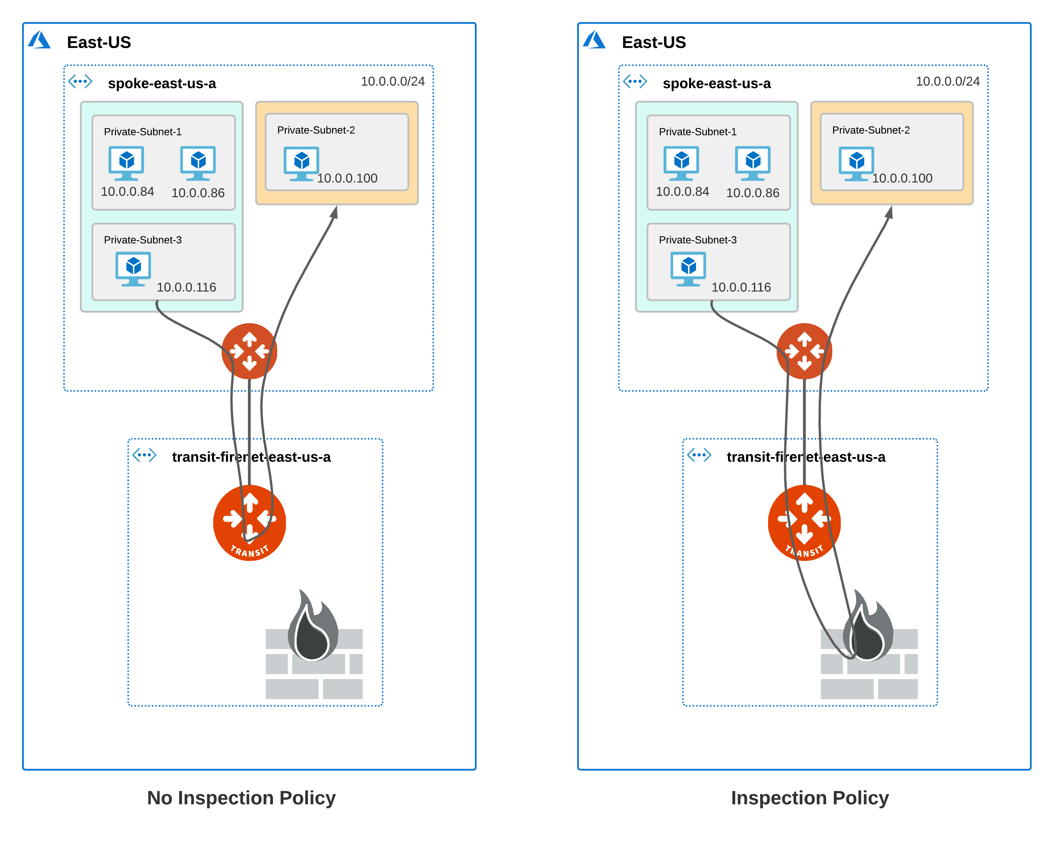
Subnet-level Inspection in Azure (released in 6.6.5404)
Subnet Groups -- Logical grouping of subnets in a VNet
Local to VNet -- unlike segmentation domains, does not span across VNets
Subnet Group name does not have to be unique across VNets
Subnet Groups may or may not have an inspection policy
If a group has inspection policy, traffic redirected to firewall, otherwise it just traverses the transit gateway
https://docs.aviatrix.com/HowTos/transit_subnet_inspection_azure.html

Slide 22
Aviatrix Transit FireNet Packet Walk

Slide 23



FireNet Packet Walkthrough – AWS Example
A Host 1.10 communicating with 2.20 with VPC A inspected via FireNet
The local route table for 1.10 has RFC1918 routes pointed to its local gateway
The local Aviatrix spoke gateway will ECMP traffic with 5-tuple hash to one of the Aviatrix Transit Gateways
The Aviatrix Transit Gateway receiving the flow will check PBR rules to determine if either source or destination requires FireNet. If a match, traffic is redirected to the one of the available FWs (it can be in the same AZ or a different AZ – when it’s in a different AZ, Transit GW sends the traffic first to the other Transit GW).
The Firewall selected will process the packet and send the traffic back to its local Transit Gateway.
The Aviatrix Transit Gateway will receive the processed packet and PBR this traffic back into the egress interface and ECMP traffic with 5-tuple hash towards the destination spokes.
The spoke gateway will receive the traffic and route the traffic out its local interface to the VPC route table. Note that this GW may not be in the same AZ as the destination instance.
The destination will receive the original traffic and see this as native VPC communication flow.
VPC A
VPC B
1
1.10
7
2.20
2
6
3
5
4
22
Notes:
May or may not be same transit GW.
Avx handles the Service Chaining, but we do not touch the Security Policies. Security team still needs to take care of that.

Slide 24
FireNet Packet Walkthrough – AWS Example
Return Flow: 1.10 communicating with 2.20 with VPC A inspected via FireNet
The local route table for 2.20 has RFC1918 routes pointed to its local spoke gateway for return traffic.
The local Aviatrix spoke gateway will ECMP traffic with 5-tuple hash to one of the Aviatrix Transit Gateways
The Aviatrix Transit Gateway receiving the traffic will pass the traffic to the the same FW which handled the initial flow to maintain symmetry (directly or via another Transit GW).
The stateful Firewall will process the return traffic and route the traffic back to its designated gateway.
The Aviatrix gateway will ECMP traffic with 5-tuple hash to one of the destination spoke gateways.
The destination spoke gateway will route this traffic out its local interface to the native VPC route table.
The original source will receive the return traffic and see this as native VPC communication flow.
VPC A
VPC B
7
1.10
1
2.20
6
2
5
3
4
23
Notes:
Aviatrix Gateways (Spoke as well as Transit) may differ, but same FW is used.
Hence no dependency on SNAT.

Slide 25

FireNet Packet Walkthrough – Azure Example
A Host 1.10 communicating with 2.20 with VNET A inspected via FireNet
VNET A
VNET B
The local route table for 1.10 has RFC1918 routes pointed to its local gateway
The local Aviatrix spoke gateway will ECMP traffic with 5-tuple hash to one of the Aviatrix Transit Gateways
The Aviatrix Transit Gateway receiving the flow will check PBR rules to determine if either source or destination requires FireNet. If a match, traffic is redirected to Azure ILB.
The Azure ILB will perform a 5-tuple hash to send the traffic to one of the backend pool members.
The Firewall selected will process the packet and send the traffic back to its defined Transit Gateway.
The Aviatrix Transit Gateway will receive the processed packet and PBR this traffic back into the egress interface and ECMP traffic with 5-tuple hash towards the destination spokes.
The spoke gateway will receive the traffic and route the traffic out its local interface to the Azure VNET route table.
The destination will receive the original traffic and see this as native Azure communication flows.
1
1.10
8
2.20
2
7
6
3
4
5
24
Notes:
In AWS, symmetry is handled by Aviatrix GWs.
In Azure, symmetry is handled by ILB. It is handling 5-tuple hashing
Controller is monitoring FW health
Again, no need for SNAT
Upon inspecting the traffic, the FW has a UDR pointing to one of the Transit gateways. That Transit GW is attached to the FW when the FW is deployed (there is a pulldown menu)
Recommendation is to alternate Transit GWs attachments to FWs so that UDR programming delays are kept to a minimum

Slide 26
FireNet Packet Walkthrough – Azure Example
Return Flow: 1.10 communicating with 2.20 with VNET A inspected via FireNet
VNET A
VNET B
The local route table for 2.20 has RFC1918 routes pointed to its local spoke gateway for return traffic.
The local Aviatrix spoke gateway will ECMP traffic with 5-tuple hash to one of the Aviatrix Transit Gateways
The Aviatrix Transit Gateway receiving the traffic will pass the traffic to the ILB. The gateway will PBR the traffic back to the ILB for FireNet.
The Azure load balancer will hash the traffic however, the reverse flow hash will match the initial flow to ensure symmetry.
The stateful Firewall will process the return traffic and route the traffic back to its designated gateway.
The Aviatrix gateway will ECMP traffic with 5-tuple hash to one of the destination spoke gateways.
The destination spoke gateway will route this traffic out its local interface to the native Azure route table.
The original source will receive the return traffic and see this as native Azure communication flows.
8
1.10
1
2.20
7
2
6
3
4
5
25
Notes:
As compared to AWS, either Transit GW can be hit.
Return traffic

Slide 27
Centralized FireNet

Slide 28
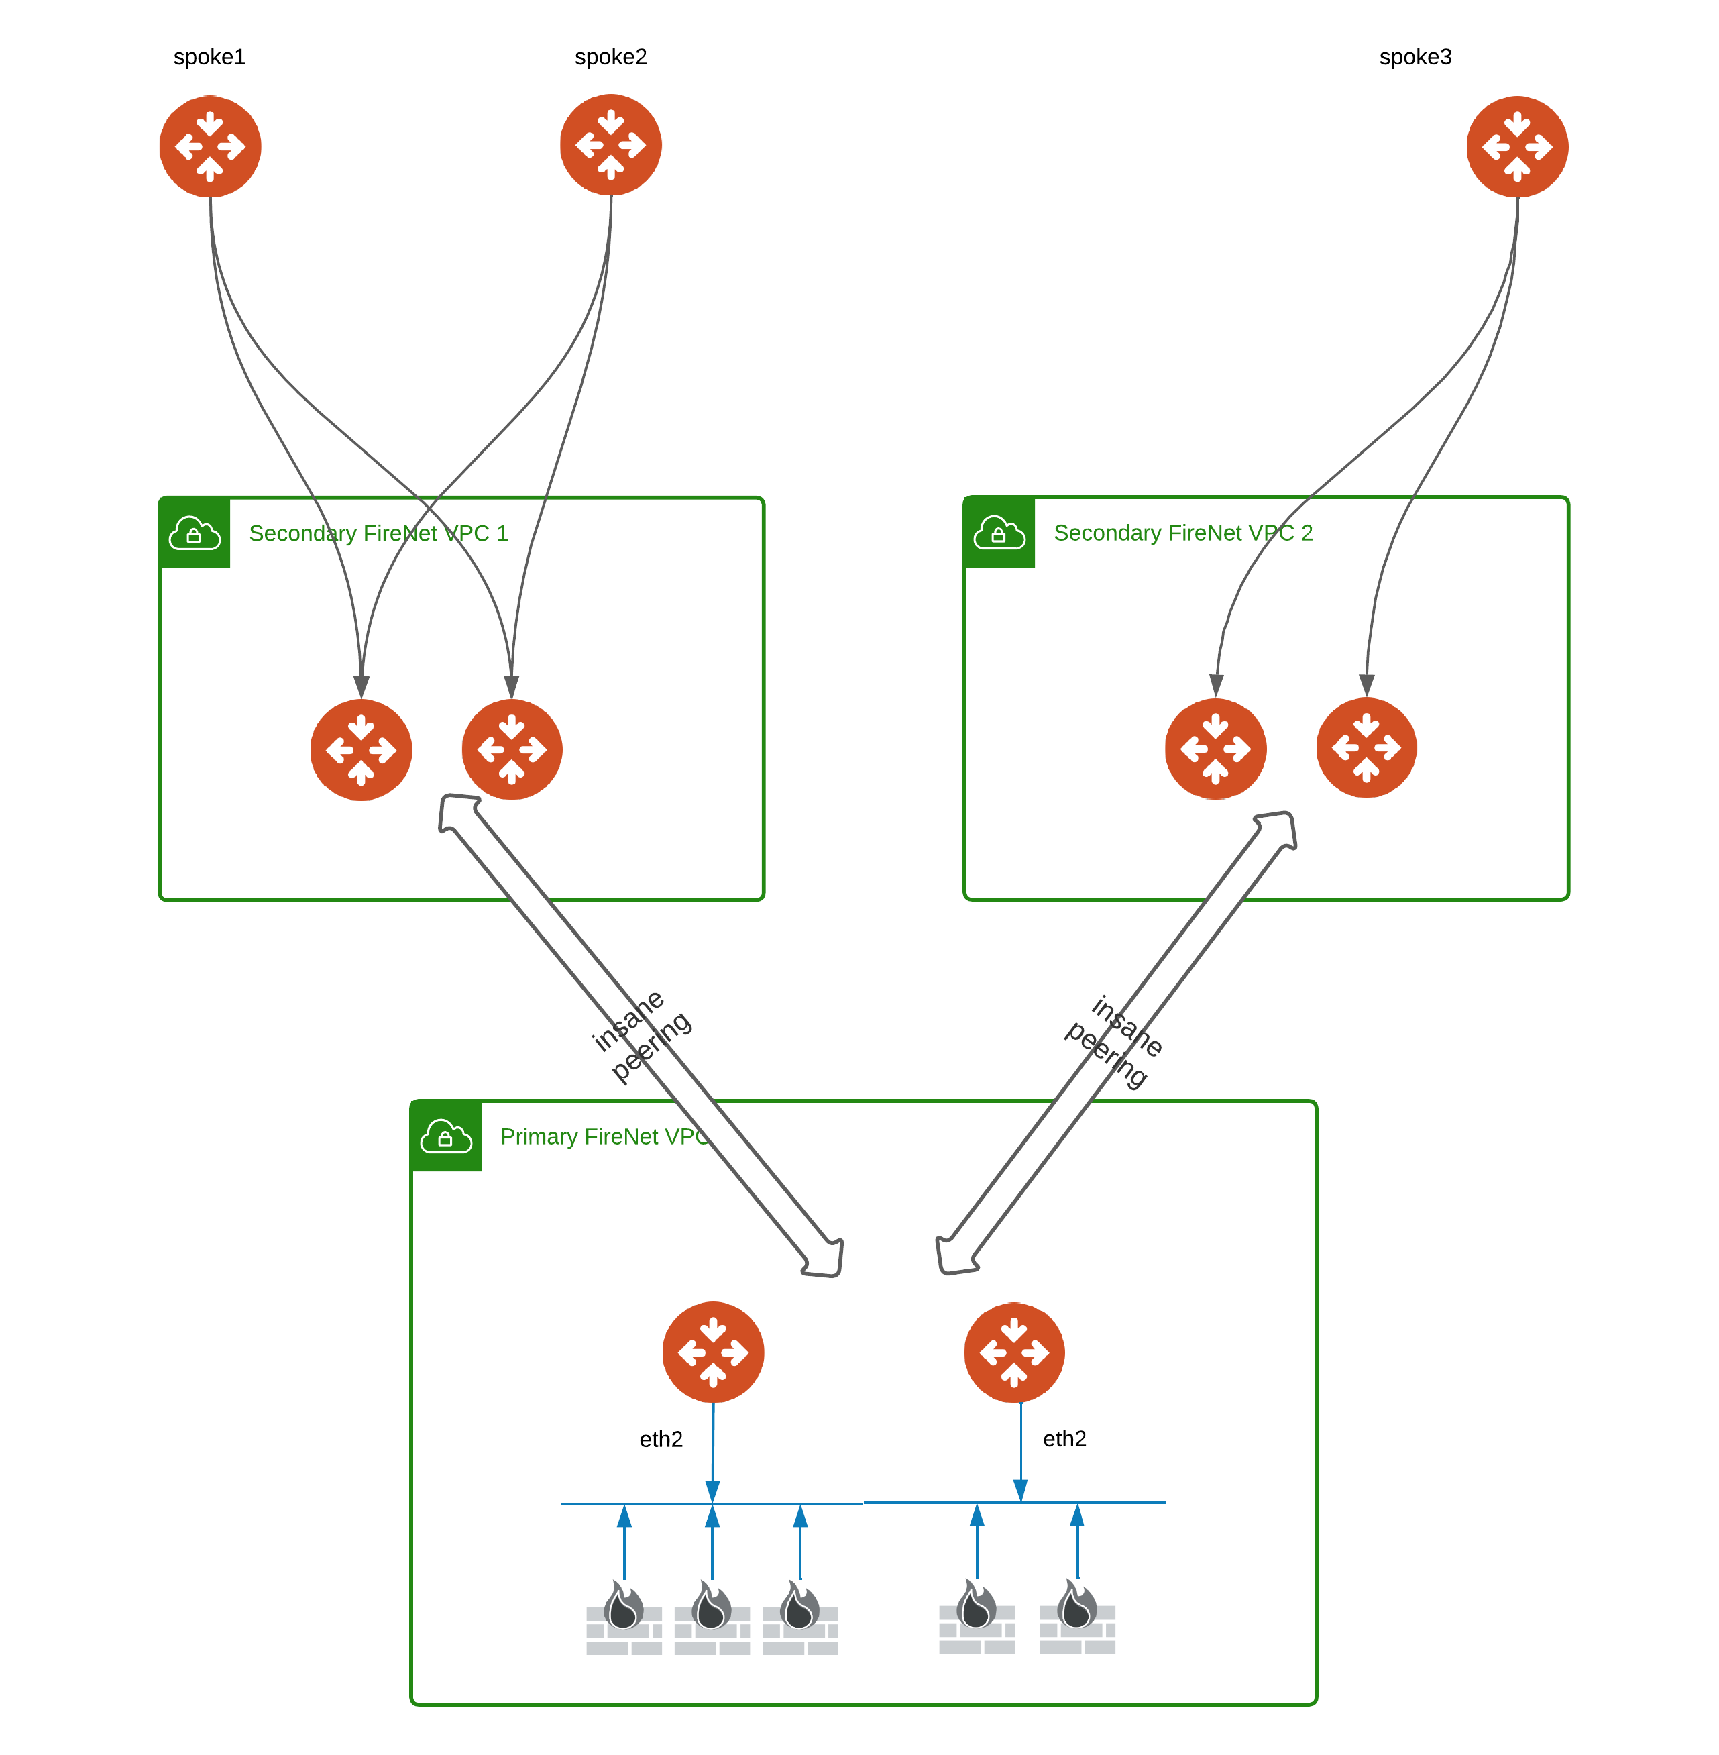
Overview
Centralized FireNet (CFN) = AWS Only + Transit FireNets + Multi-Tier Transit
  2-tier MTT architecture
  Spokes can be AWS or non-AWS
Terminology
  SFN – Secondary FireNet
  PFN – Primary FireNet

Slide 29
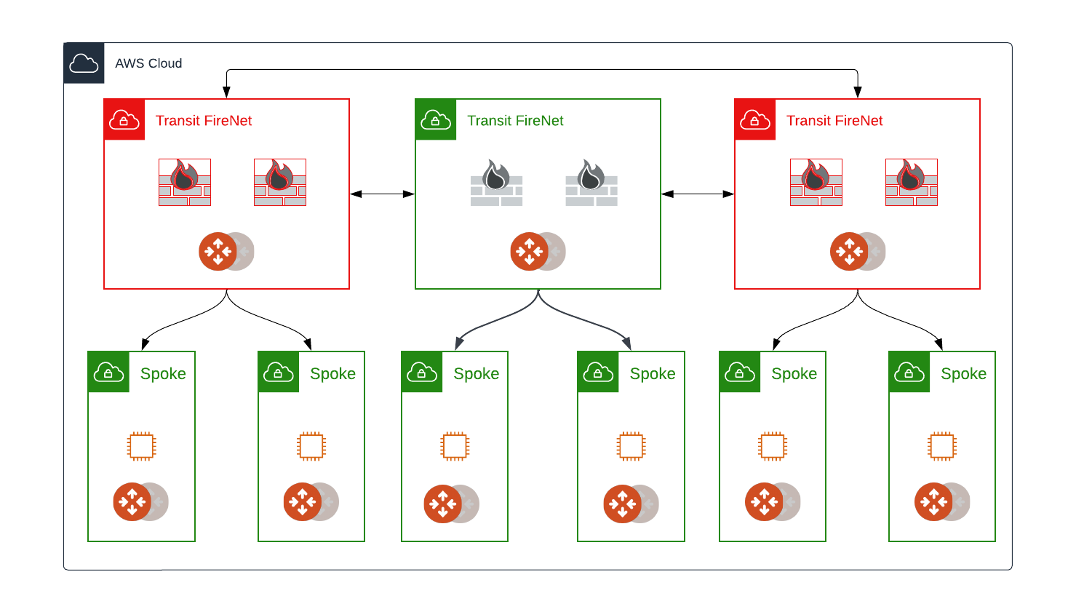
Traditional Model

Slide 30
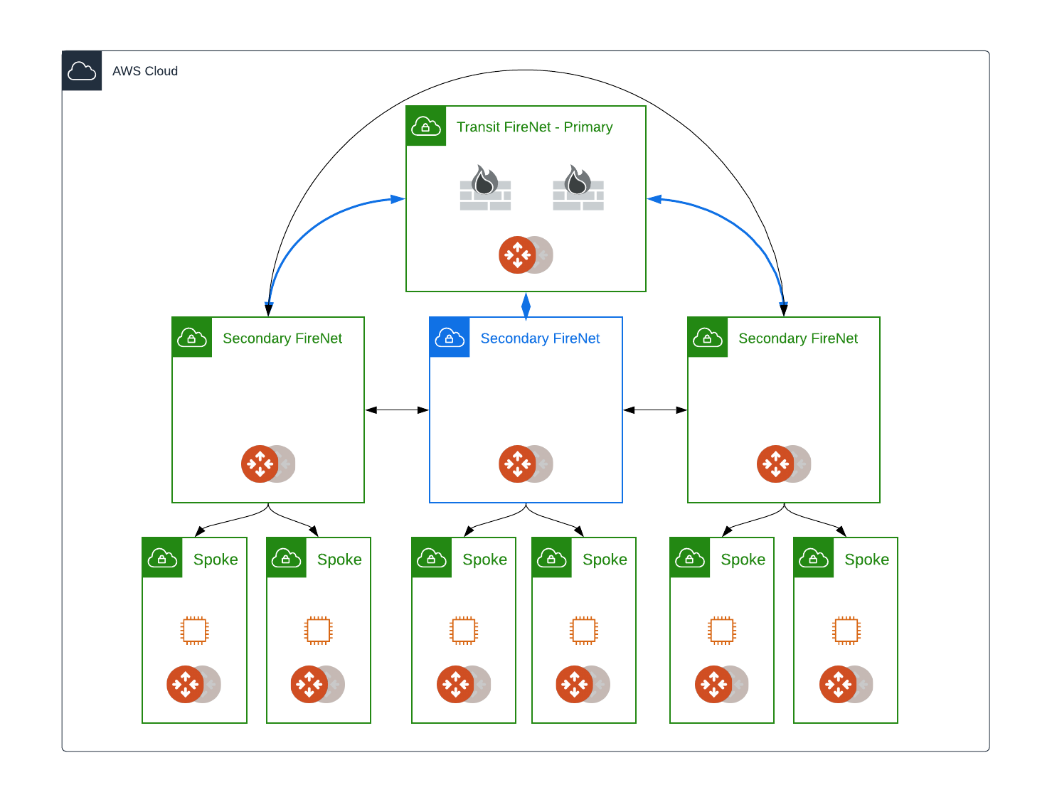
Centralized FireNet Model

Slide 31
Summary
Transit FireNet makes security service insertion MUCH MUCH EASIER!
All four major CSPs supported
Consistent insertion across CSPs
Easily direct traffic from selected Spokes to Transit FireNet for Layer 7 inspection

Slide 32
Next: Lab 7 - FireNet

